Slide 1
Threat Modeling
The Ultimate DevSecOps

Slide 2
About me
Cloud SecOps at Capital One
Ex DevOps/SysAdmin/NOC engineer
Hates word documents and spreadsheets
Loves putting everything in Git
Threat modeling enthusiast
Created ThreatSpec and the OWASP Cloud Security project

Slide 3
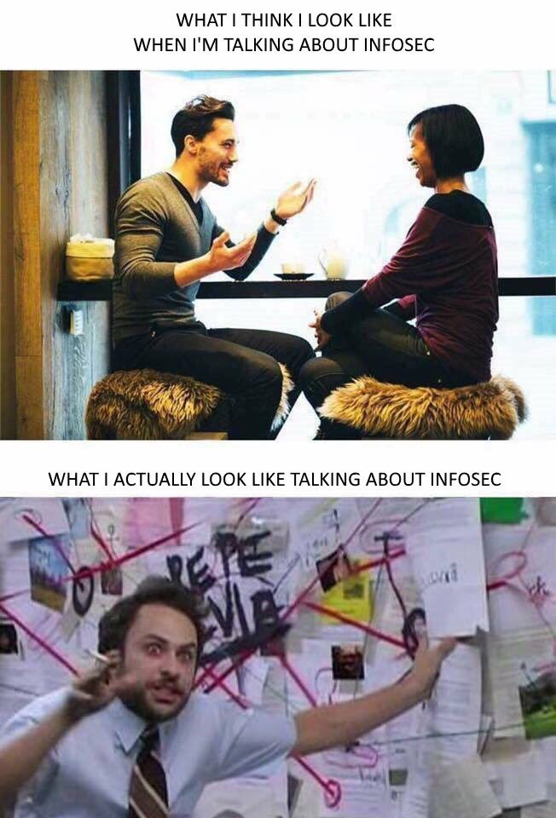

https://twitter.com/Ch33r10/status/917061385279856640
Notes:
I saw this tweet the other week and it made me laugh. I can definitely relate, so you have been warned.
https://twitter.com/Ch33r10/status/917061385279856640

Slide 4
“Software is eating the world”
Marc Andreessen

Slide 5

https://drawception.com/player/686396/3slimy5me/

Slide 6

https://imgflip.com/memegenerator/Scared-Cat

Slide 7
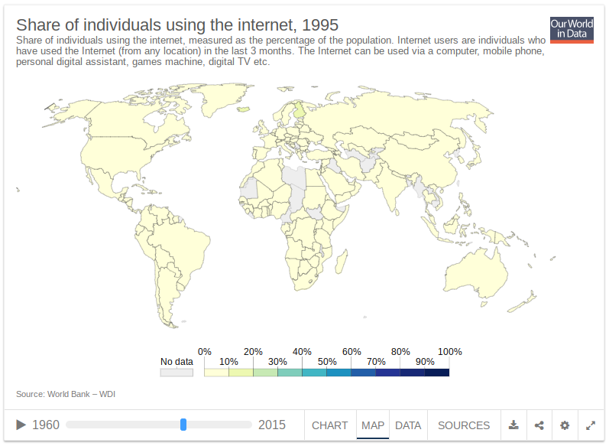
https://ourworldindata.org/internet

Slide 8
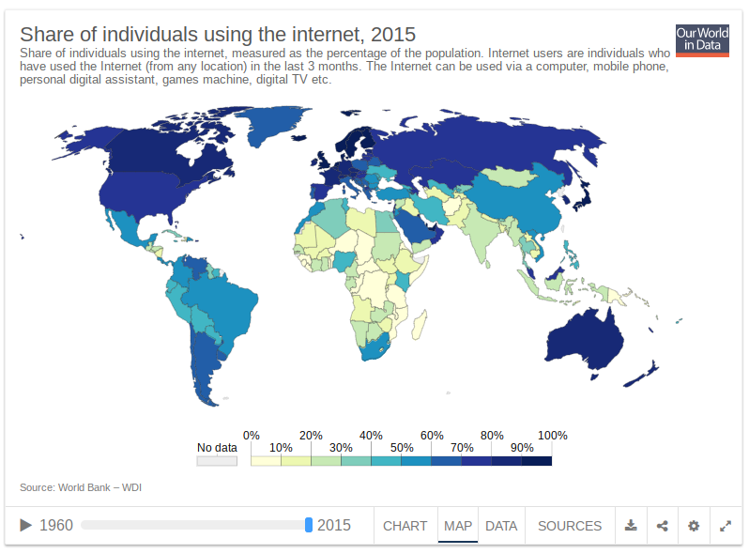
https://ourworldindata.org/internet

Slide 9
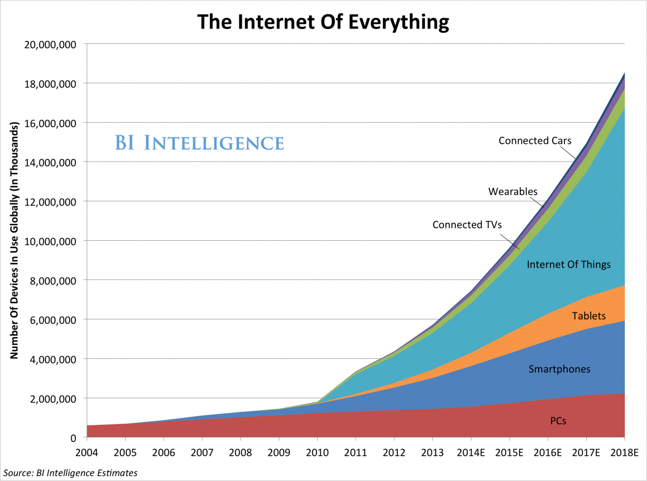
https://www.businessinsider.com.au/the-internet-of-everything-2014-slide-deck-sai-2014-2#-1

Slide 10
In the top 10 biggest companies by market capitalisation
Amazon Apple Facebook Google Microsoft
Notes:
https://www.forbes.com/sites/stevedenning/2018/01/02/why-agile-is-eating-the-world%E2%80%8B%E2%80%8B/#6c9732a24a5b
https://en.m.wikipedia.org/wiki/List_of_public_corporations_by_market_capitalization

Slide 11
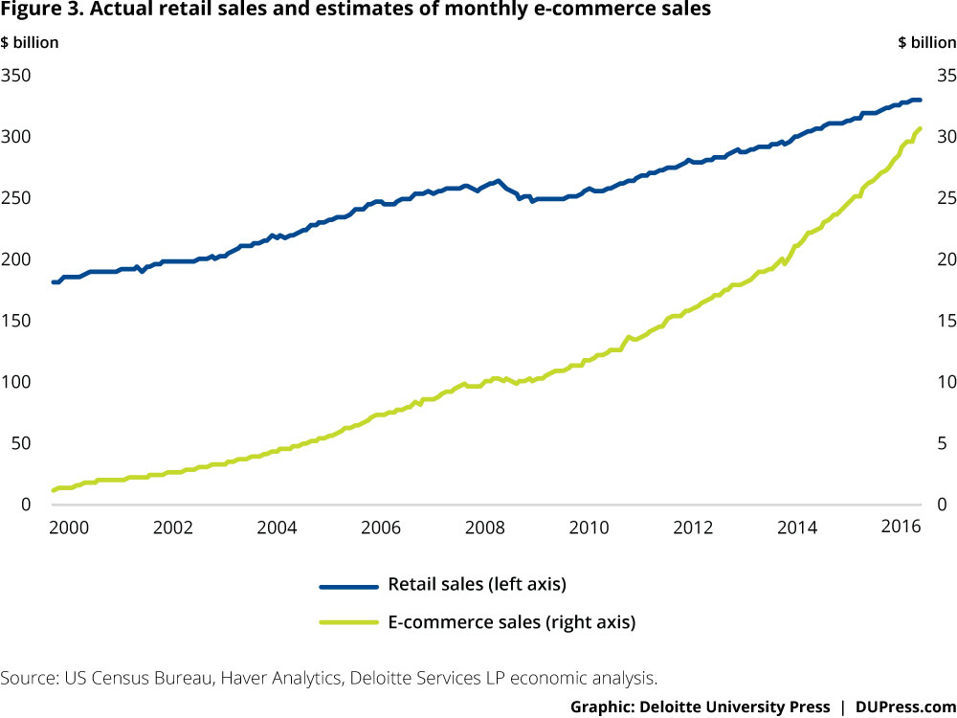
https://www2.deloitte.com/insights/us/en/economy/behind-the-numbers/holiday-ecommerce-sales-growth-forecast.html

Slide 12
GitHub The State of the Octoverse 2017
24 million users 1.5 million organisations 67 million repositories 1 billion public commits since september 2016 52% of Fortune 50 companies using GitHub Enterprise 45% of Fortune 100

Slide 13
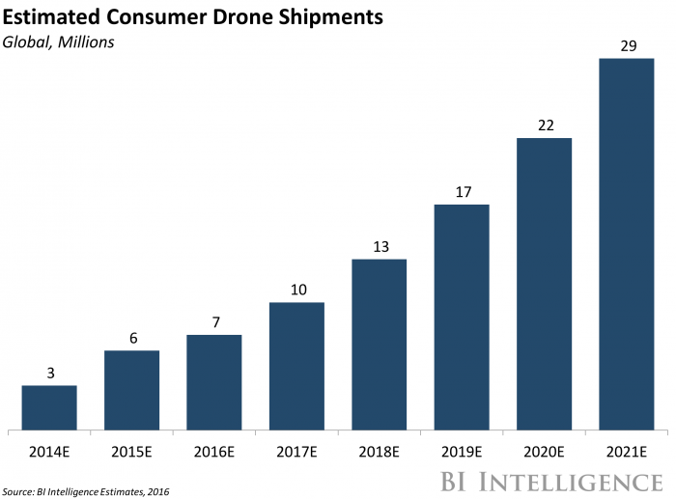
http://uk.businessinsider.com/drone-industry-analysis-market-trends-growth-forecasts-2017-7?r=US&IR=T

Slide 14
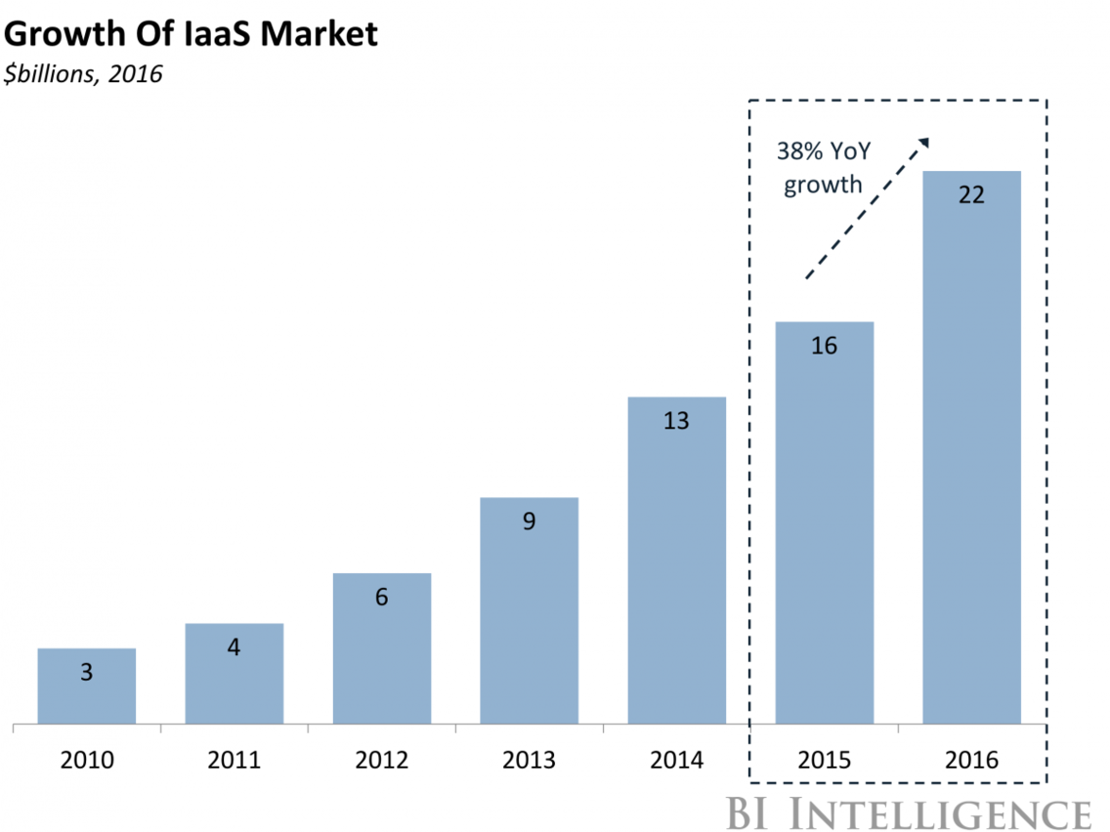
http://uk.businessinsider.com/the-cloud-computing-report-an-introduction-to-cloud-solutions-and-their-use-cases-2017-1?r=US&IR=T

Slide 15
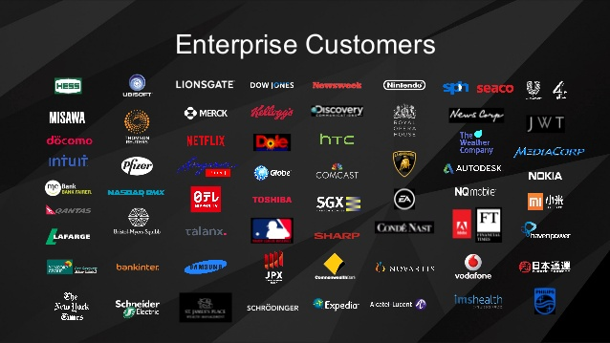
Aws customers
https://www.slideshare.net/mobile/AmazonWebServices/aws-summit-singapore-keynote-with-stephen-orban-head-of-enterprise-strategy

Slide 16
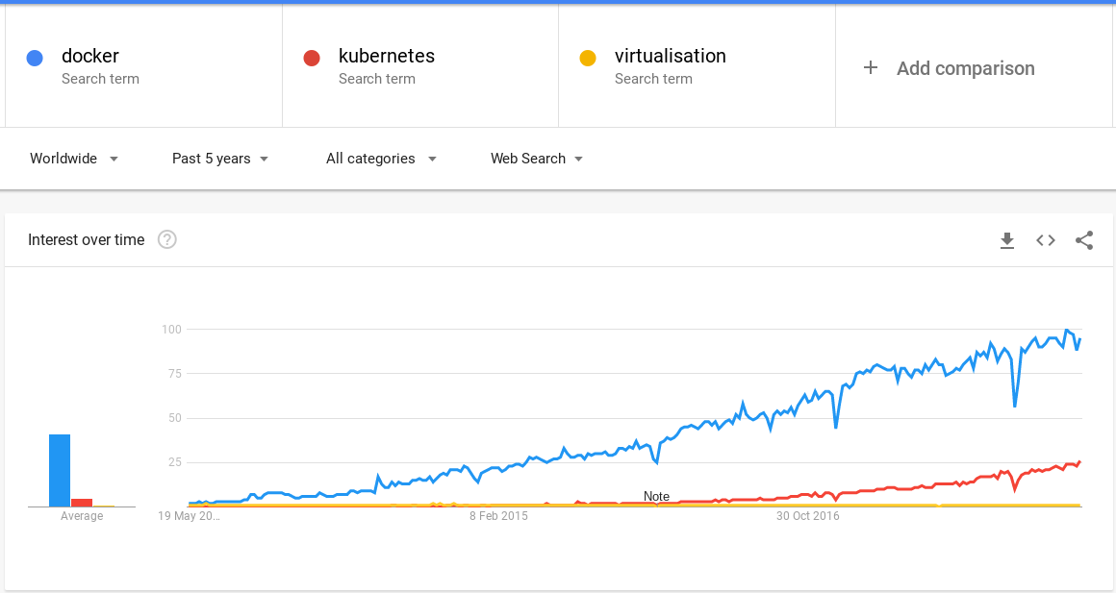
http://www.datacenterdynamics.com/content-tracks/colo-cloud/how-containers-are-changing-the-dynamics-for-data-centers/98445.fullarticle

Slide 17
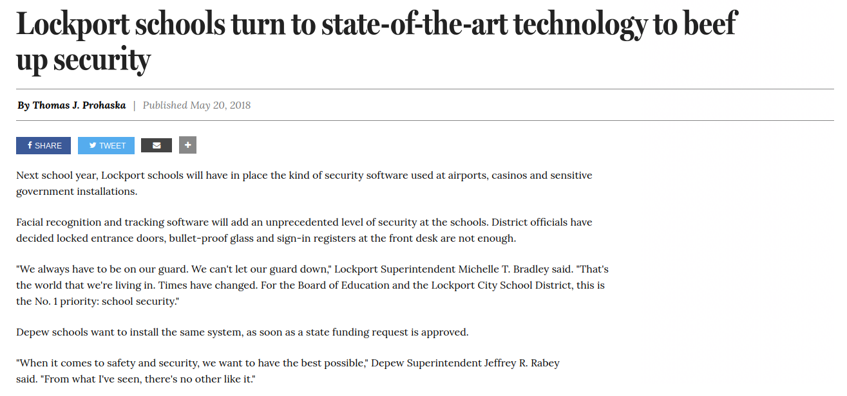
http://buffalonews.com/2018/05/20/lockport-schools-turn-to-state-of-the-art-technology-to-beef-up-security/

Slide 18
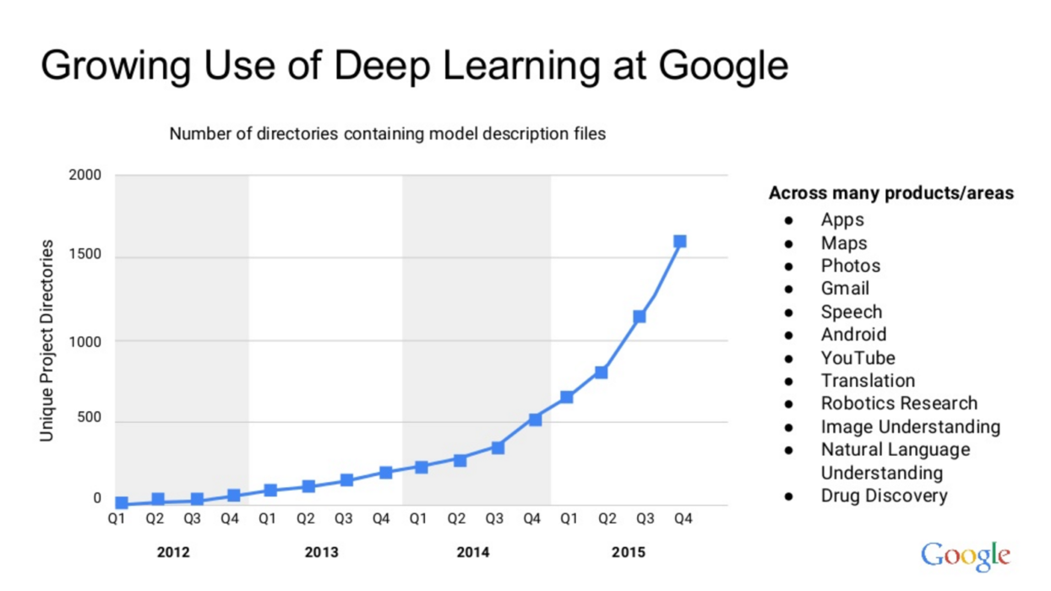
https://instinct.radeon.com/en/the-potential-disruptiveness-of-amds-open-source-deep-learning-strategy/

Slide 19

Is security keeping up?
https://www.snopes.com/fact-check/wolf-pack-photo/

Slide 20
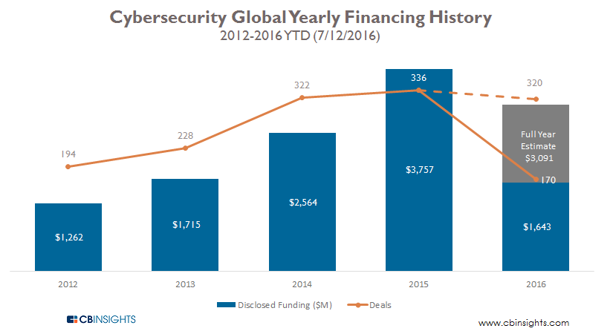
https://www.cbinsights.com/research/cybersecurity-startups-funding-trends-q2-2016/

Slide 21
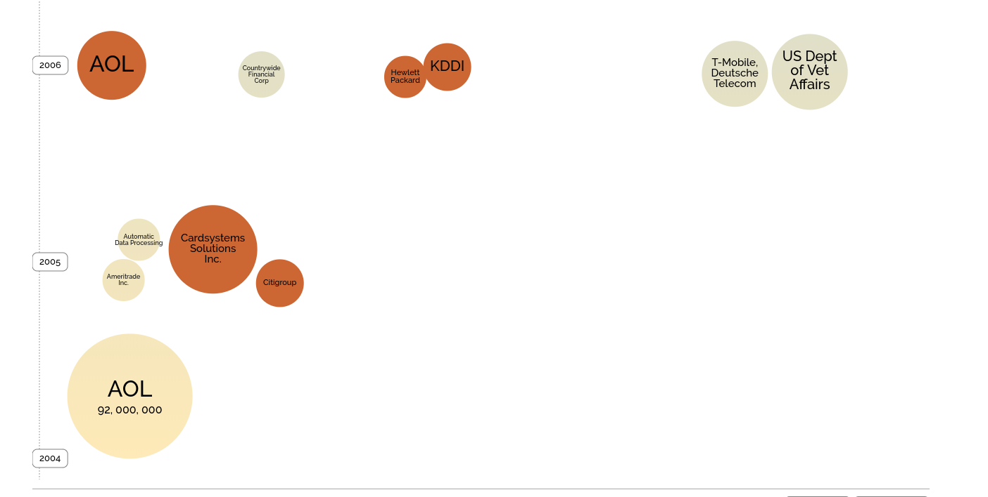
Scale of breaches: Then
http://www.informationisbeautiful.net/visualizations/worlds-biggest-data-breaches-hacks/

Slide 22
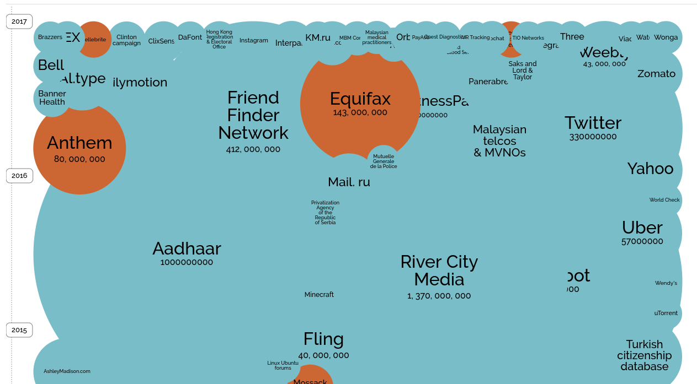
Scale of breaches: Now
http://www.informationisbeautiful.net/visualizations/worlds-biggest-data-breaches-hacks/

Slide 23
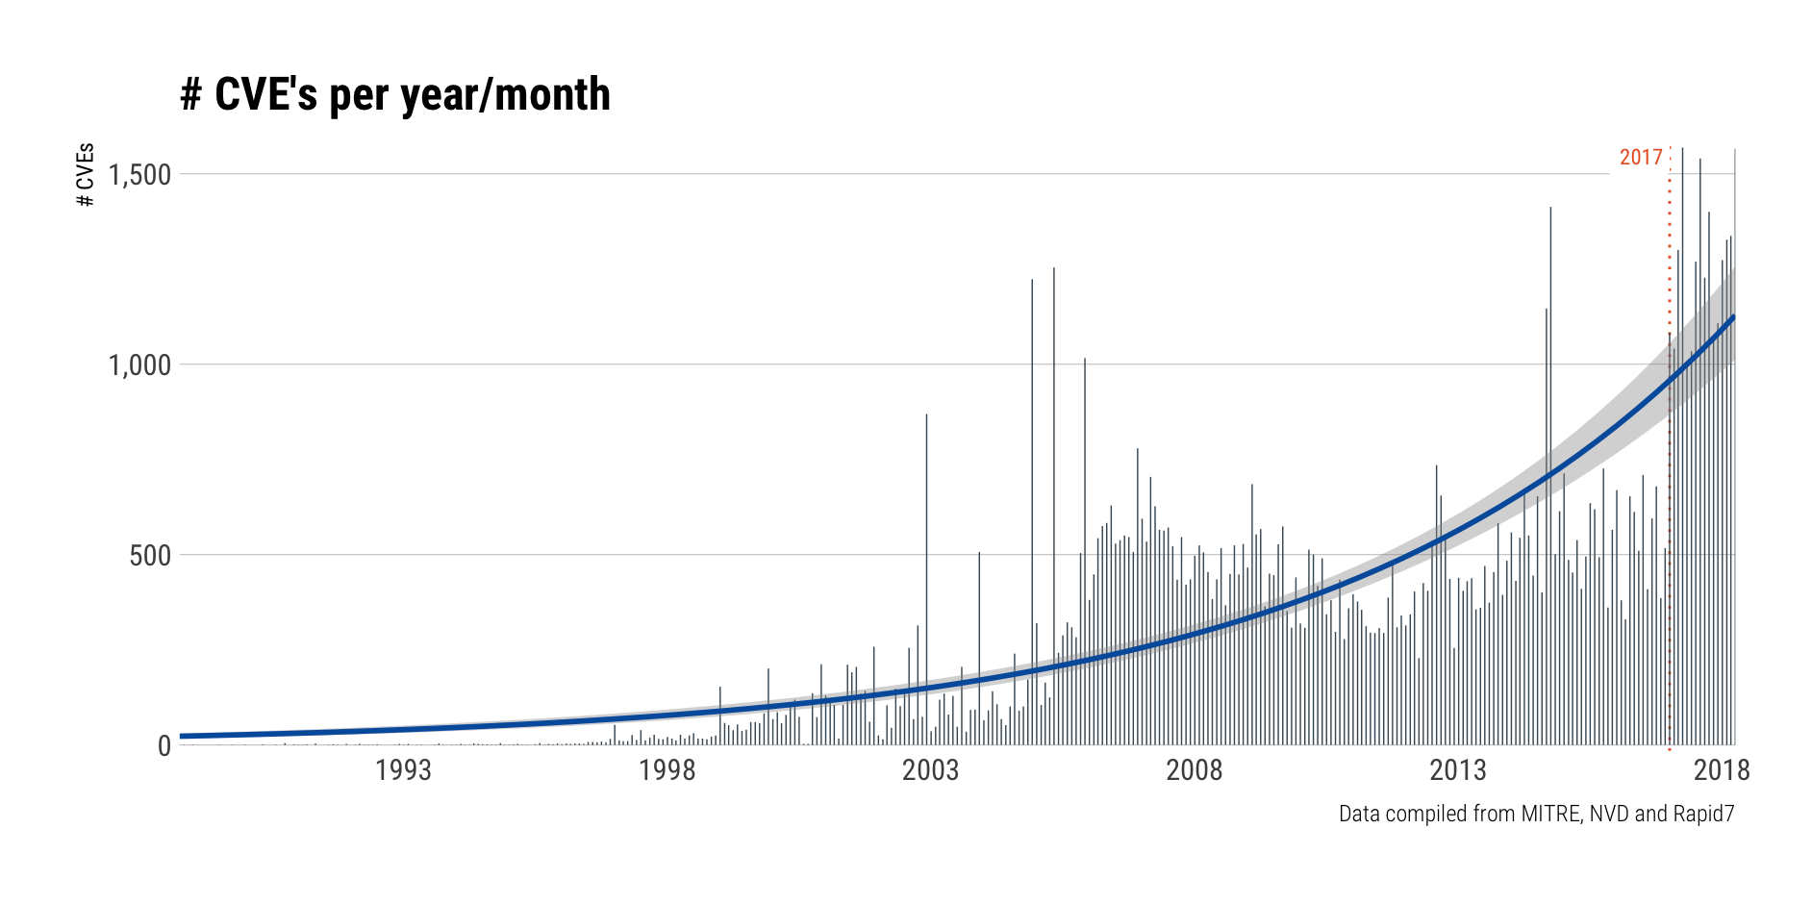
Number of vulnerabilities
https://blog.rapid7.com/2018/04/30/cve-100k-by-the-numbers/

Slide 24
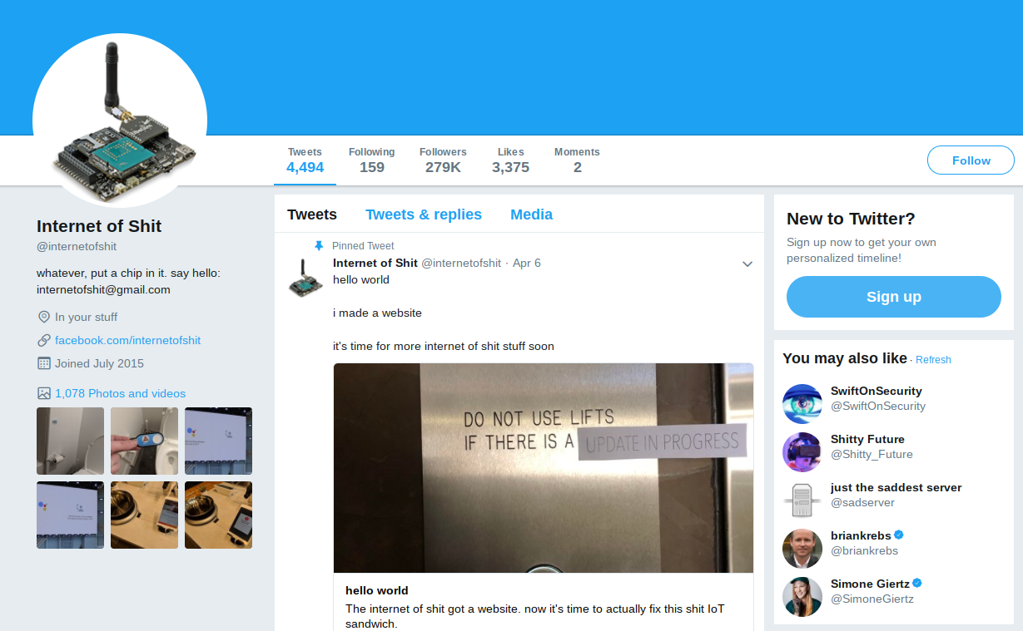
https://twitter.com/internetofshit

Slide 25
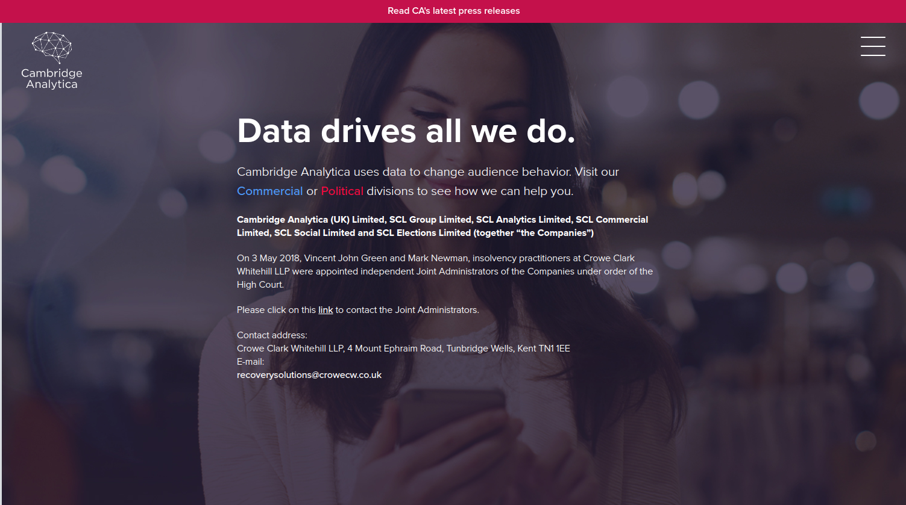
https://cambridgeanalytica.org/

Slide 26
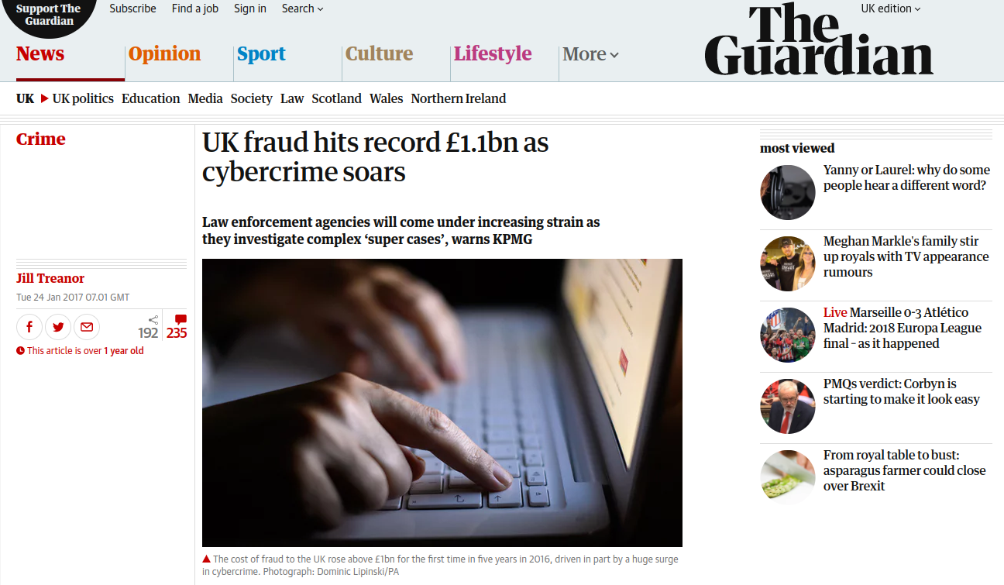
UK Cybercrime
https://www.theguardian.com/uk-news/2017/jan/24/uk-fraud-record-cybercrime-kpmg

Slide 27
Computers are EVERYWHERE
and we need to get better at securing them

Slide 28

https://www.taleas.com/memes/i-m-getting-tired-of-all-this-doom-and-gloom-why-can-t-i-just-open-up-my-own-hair-salon-an.html

Slide 29

Silicon Valley MomBot 2.0
http://sonic.wikia.com/wiki/Mombot

Slide 30

Hans Jørgen Wiberg

Slide 31
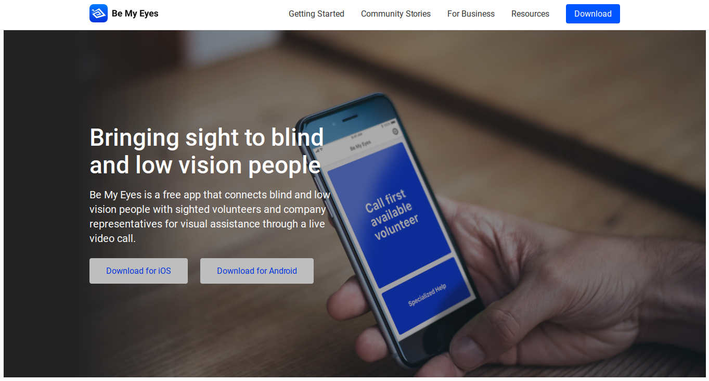
Be My Eyes
https://www.bemyeyes.com/

Slide 32
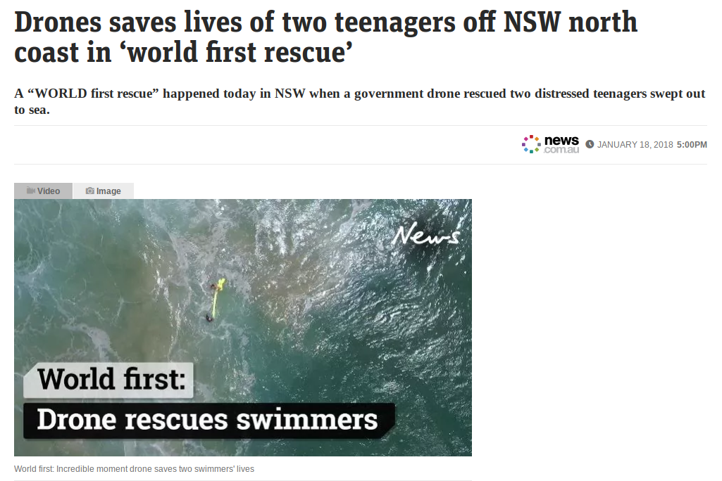
http://www.news.com.au/technology/innovation/inventions/drones-saves-lives-of-two-teenagers-off-nsw-north-coast-in-world-first-rescue/news-story/97fccbe0b081c3c380face170d72b09c

Slide 33

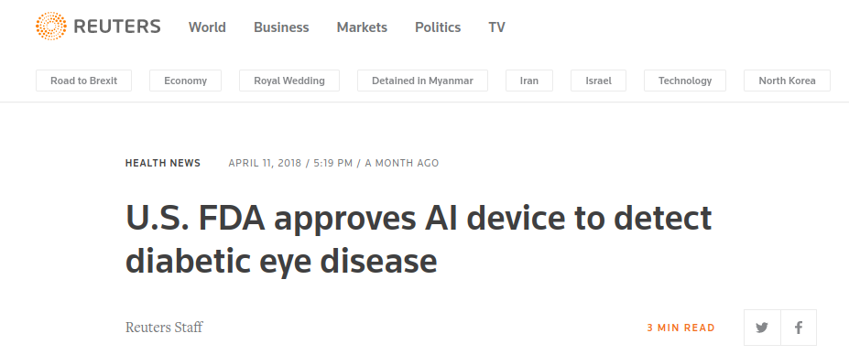
https://hbr.org/2018/03/using-ai-to-invent-new-medical-tests
https://uk.reuters.com/article/us-fda-ai-approval/u-s-fda-approves-ai-device-to-detect-diabetic-eye-disease-idUKKBN1HI2LC

Slide 34
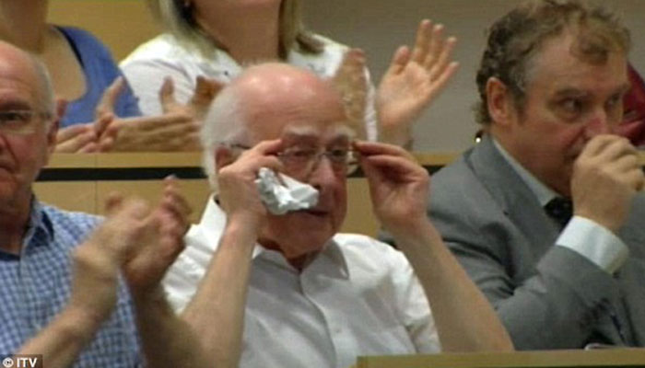

300 GB/s of raw data
300 MB/s after filtering
27 GB of data stored per day
25 petabytes stored per year
Notes:
Detectors generate about 300gbps of raw data, 300 mbps after filtering, 27 GB of raw data per day, 25 petabytes per year

Slide 35

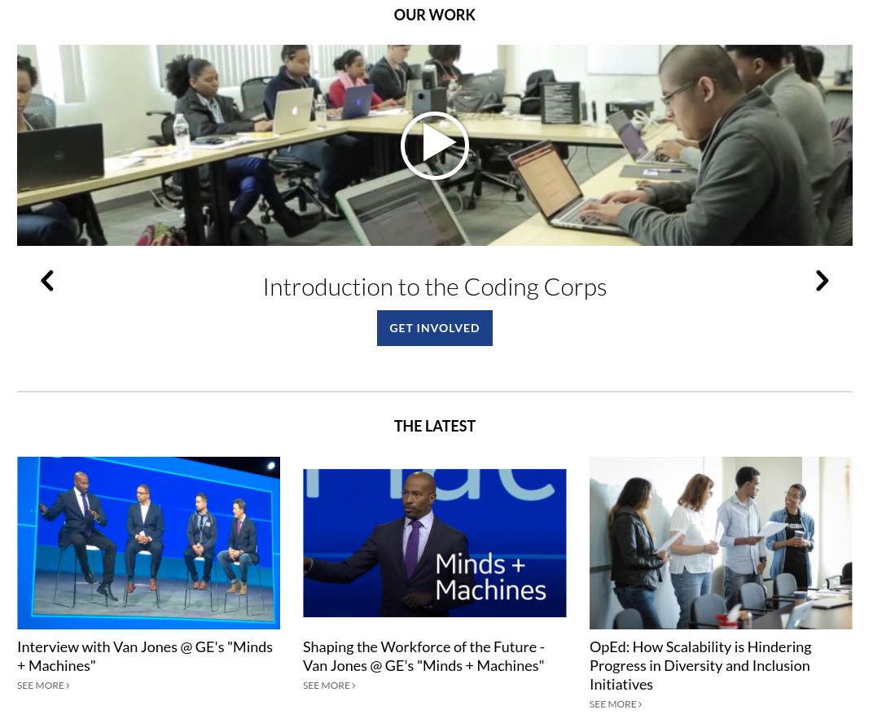
https://www.yeswecode.org/

Slide 36

https://www.reddit.com/r/AdviceAnimals/comments/8kp3vi/ive_never_been_happier_in_my_life/

Slide 37
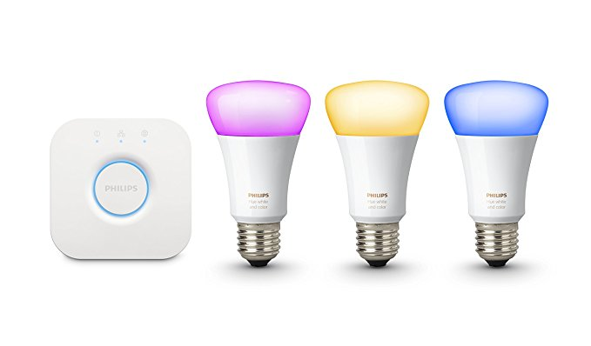

https://www.amazon.co.uk/Philips-Ambiance-Wireless-Lighting-Starter/dp/B01K1WP7Z4
https://www.amazon.co.uk/Amazon-Echo-Dot-Generation-Black/dp/B01DFKBL68

Slide 38

Software is hugging the world
https://drawception.com/panel/drawing/b1AY6336/danger-dolan-hugging-the-world/

Slide 39
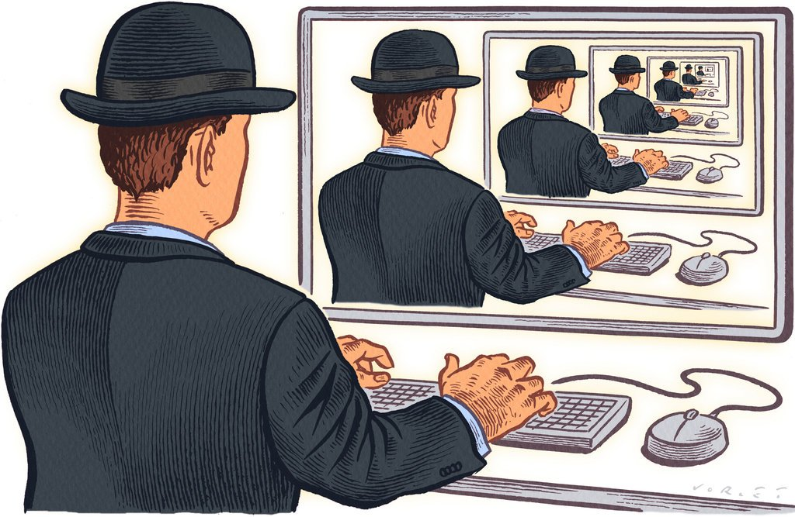
The InfoSec Echo Chamber
Other risks:
Environmental
Regulatory
Geo-political
Market
https://www.nytimes.com/2011/05/29/technology/29stream.html

Slide 40
Let’s find ways to enable all of this cool stuff in a way that is secure, and protects privacy and other digital rights.

Slide 41
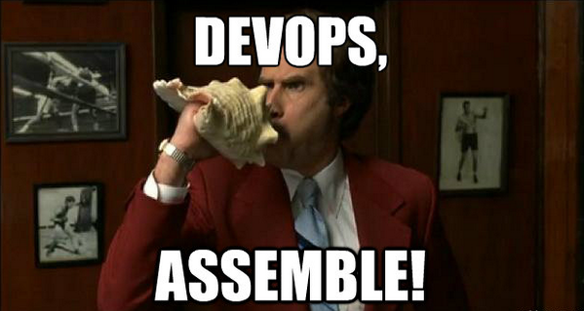

Enablement
Opportunity
https://twitter.com/vickycharra/status/375254199547609089
Notes:
Example: automation, blameless culture

Slide 42
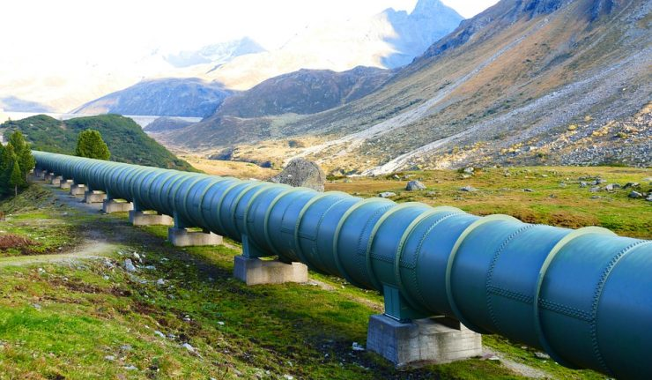
DevSecOps
Shift security left
https://visegradpost.com/en/2017/11/01/the-eastring-pipeline-project-is-launched/

Slide 43
Shift security
thinking left

Slide 44
Where we were | Where we are | Where we’re heading
Department of “no” Isolated skills Unaligned from business needs Driven by tech | Security in the pipelines Security benefits of automation and cloud | Engagement Education Empowerment

Slide 45
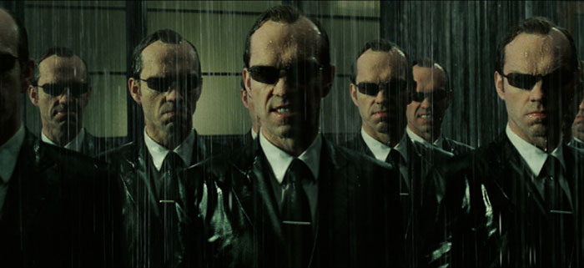
Bug bounties
https://www.matrixfans.net/interview-with-darrin-prescott-stunt-double-agent-smith-from-the-matrix-reloaded-and-revolutions-2003/
Speaking to tester

Slide 46
Writing security tests
@session_management
Feature: Session Management
Verify that there are no weaknesses in the session management implementation
@iriusrisk-cwe-664-fixation
Scenario: Issue a new session ID after authentication
Given a new browser or client instance
And the login page
And the value of the session ID is noted
When the default user logs in
And the user is logged in
Then the value of the session cookie issued after authentication should be different from that of the previously noted session ID
https://github.com/continuumsecurity/bdd-security/blob/master/src/test/resources/features/session_management.feature

Slide 47

Security champions
https://www.mmamania.com/2017/12/6/16743010/despite-ufc-getting-into-boxing-holly-holm-has-no-desire-return-sweet-science-mma
Notes:
Linkedin Post

Slide 48

Threat modeling
https://www.everythingwingchun.com/WING-CHUN-DUMMY-Warrior-Compact-Wall-Mounted-p/myj-wma-compact.htm

Slide 49

It’s easy, you already do it...
https://pxhere.com/en/photo/722219

Slide 50
Why threat model?
Find security issues sooner and cheaper - help to deliver on time and in scope
Even for production systems, find and fix threats before the hackers find them
Puts controls into context, help prioritise investment
Brings security closer to other teams

Slide 51
So why aren't more people doing it?
WARNING: This next section contains wild speculation ;)

Slide 52

Not a blinky box you can buy, install and ignore
http://www.itpro.co.uk/server/28801/dell-emc-gains-server-market-share-at-hpes-expense

Slide 53


Slide 54
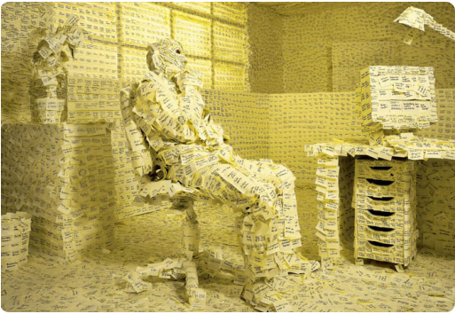
There are “other” priorities
http://racehq.com/escaping-the-curse-of-the-sticky-note-man/
Notes:
Hardest, good practice eg. automation or testing

Slide 55
Start simple
Keep it lean
Learn & adapt

Slide 56
The Threat Modeling ecosystem is growing.
There are increasing numbers of open source projects, commercial tools, approaches & methodologies, and more varied applications and use cases.

Slide 57
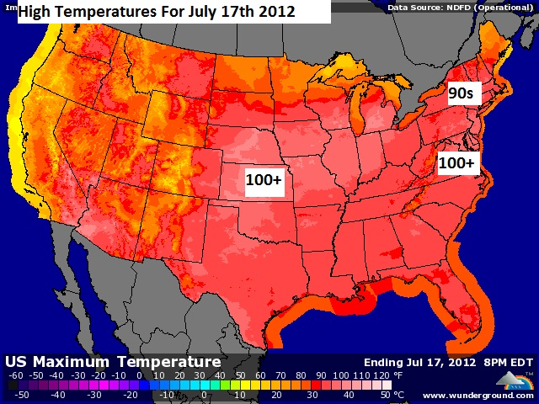
Threat Modeling Forecast
HOT
HOT
HOT
HOT
https://www.boston.com/weather/weather/2012/07/17/very_hot_today_cooling_trend_b

Slide 58
Threat Modeling Walk-through

Slide 59
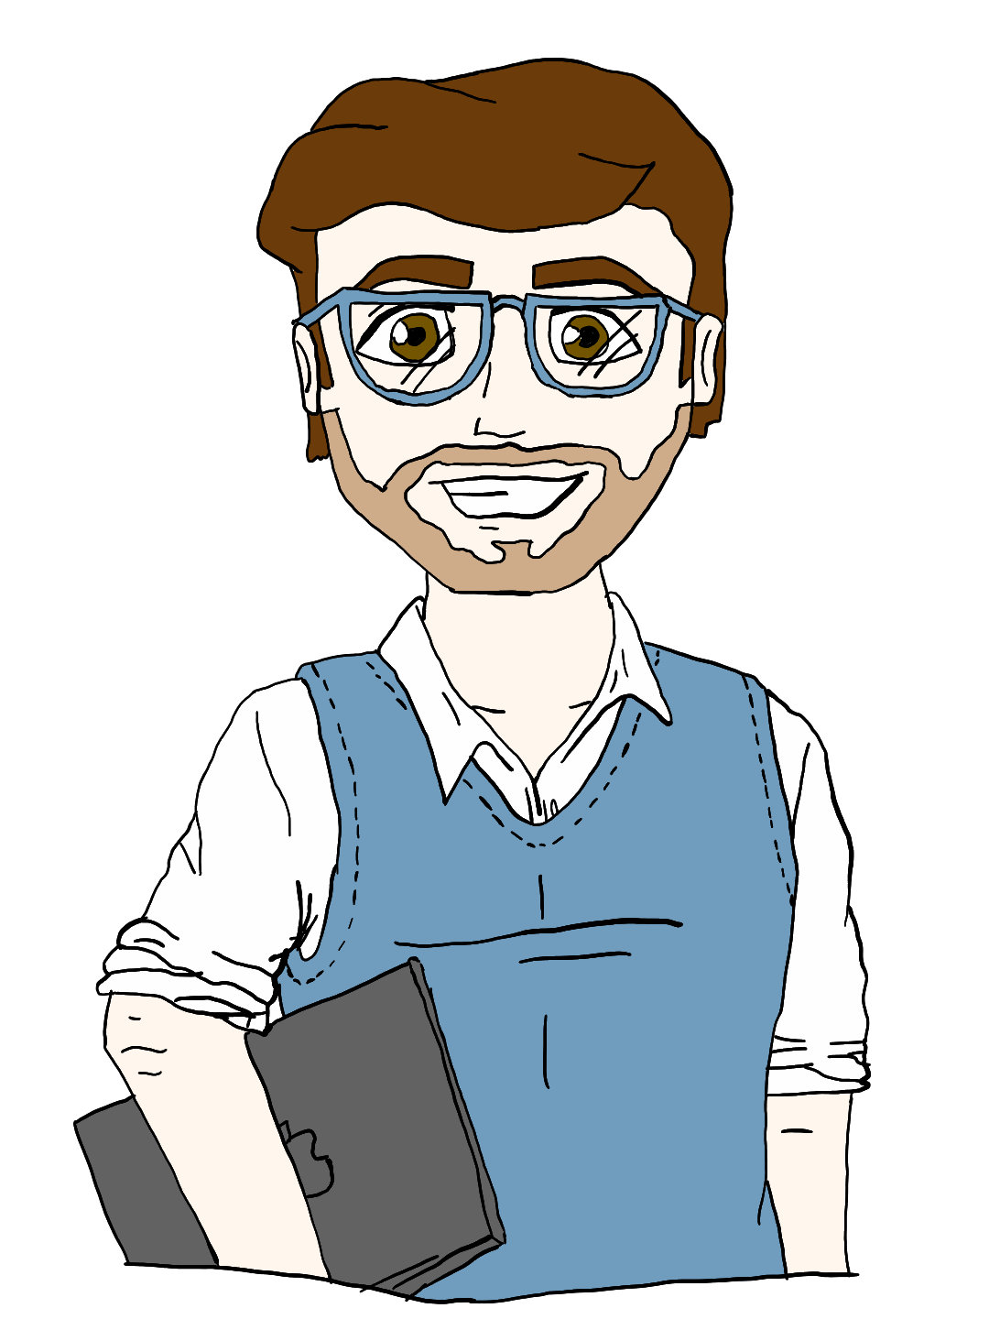
This is Mark. He’s a developer.
Profile
Working to tight deadlines
Needs to get something working asap
Will have to support services once live
Loves full-stack work
New to cloud
Always considers end users, accessibility champion
Image credit: Rebecca Manning

Slide 60
Mark’s task
Feature:
In order to ensure the quality of 3rd-party data submissions
As a business analyst
I want a data parsing and validation engine
Requirements:
Web-based API to replace existing system
Validate subset of the data against our 3rd-party partner
Transform and scrub data where needed
Write processed data objects to S3 so new backend process can pick them up

Slide 61
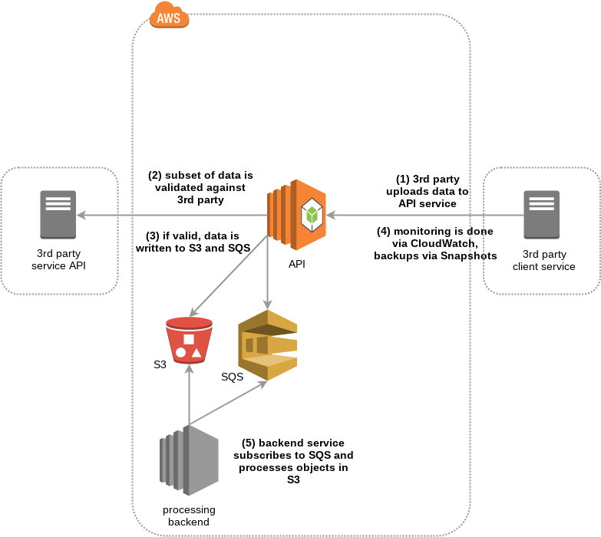

Slide 62
Hey Tara. Would you mind taking a look at this design with me? I’d love to know whether I’m missing any key operational things.

Slide 63

This is Tara. She’s an operations engineer.
Profile
Loves metrics and graphs
Big fan of IaC and config management
Works closely with devs, helping them to automate deployments etc.
Believes containers are the future
Moto is “Fail fast, fail often”
Image credit: Rebecca Manning

Slide 64
This looks great Mark. How are you doing monitoring, logging and backups?
Not sure yet. Is there a cloud service I could be use?
Of course! You can use CloudWatch for monitoring and logging, and Snapshots for backups. Something like this….

Slide 65
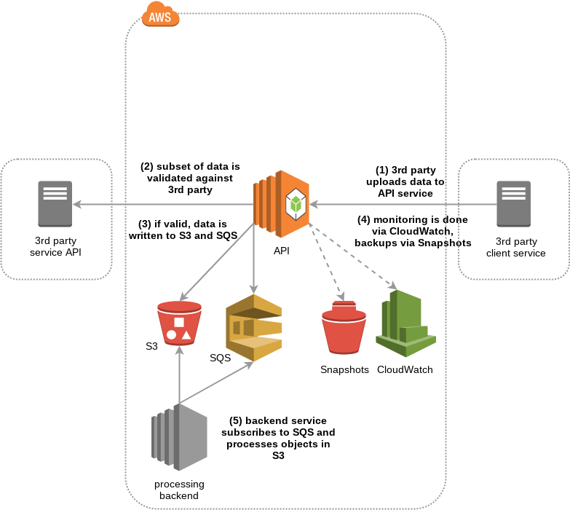
Let’s add the ops stuff

Slide 66
Hmmm. Some of the data we’re handling is pretty sensitive. Do you think it looks ok in terms of security?
I can’t see anything obviously bad. Perhaps we can ask Emily to take a look. She works in the security team.
Great! I don’t really know anyone in that team. Thanks for helping.

Slide 67

This is Emily. She’s a security engineer.
Profile
Used to be a developer, then got into pentesting
Got bored of breaking stuff and wanted to start fixing things
Wants to help people build awesome and secure services
Privacy and digital rights advocate
Image credit: Rebecca Manning

Slide 68
Hi Emily, I’m Mark. Tara and I were wondering if you could take a look at a design. We need to know there aren’t any obvious security problems.
Absolutely! I can take a look, or we could even try threat modeling it.
Threat modeling? What’s that?

Slide 69
Well, there are lots of different ways to threat model, but it essentially involves findings threats and deciding what to do about them. A great starting point is to ask 4 questions: What are you building?
What can go wrong?
What are you going to do about it?
Are you doing a good job of answering the above 3 questions.

Slide 70
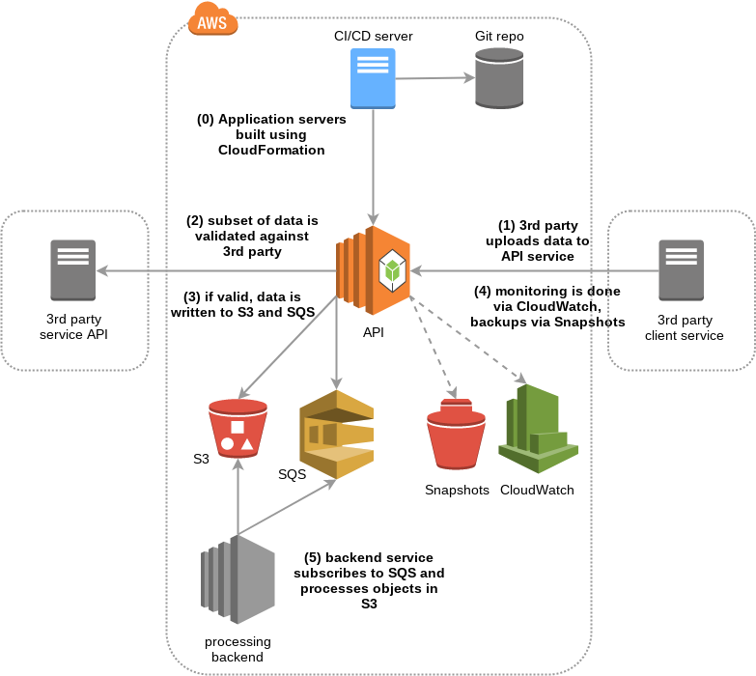
What’s building all of this stuff in the cloud?

Slide 71
So now we know what we’re building, let’s add some trust boundaries. These are demarcation points between different levels of privilege, access or security concern.

Slide 72
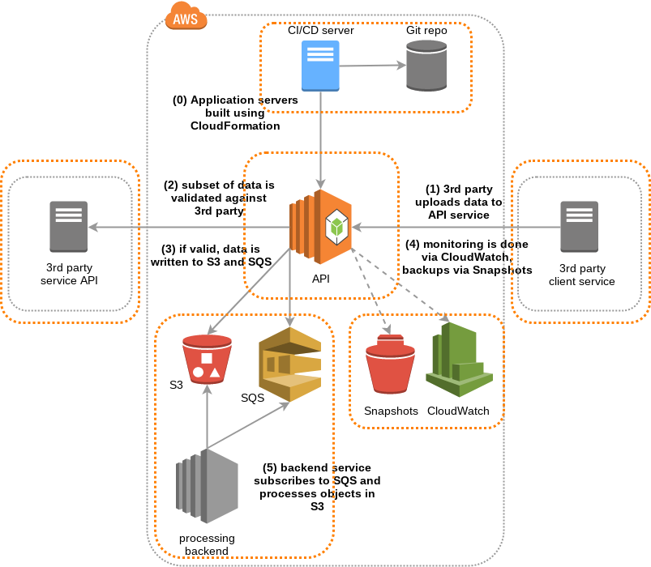
Now we also have some trust boundaries

Slide 73
Now we need to think about possible threats. As you’re using various cloud services, we could look at the OWASP Cloud Security project to see if any of those threats are relevant.
What’s that?
It’s a growing collection of cloud threats and mitigations expressed as BDD stories.
Oh cool! I’m a huge fan of BDD!

Slide 74
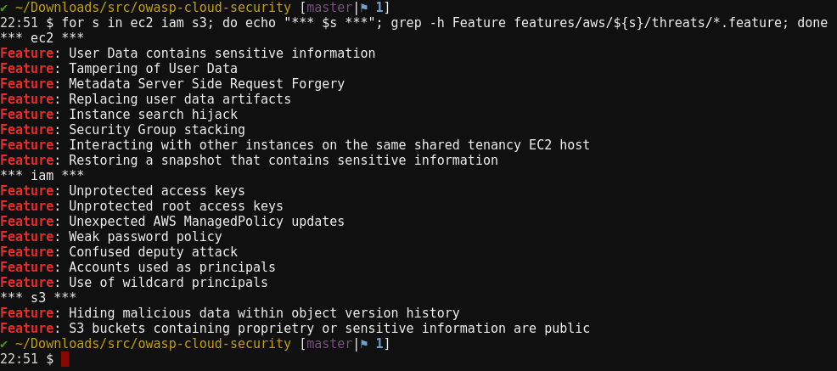
Notes:
OCST-1.1.1 - sensitive data in user data (build)
OCST-1.1.8 - recovering stored snapshot (backups)
OCST-1.3.1 - unprotected IAM access keys (git)
OCST-1.2.2 - private buckets are public (customer data)

Slide 75
# Id: OCST-1.1.1
# Status: Confirmed
# Service: AWS EC2
# Components:
# - User Data
# STRIDE:
# - Elevation of privilege
# - Information disclosure
# References: # - https://docs.aws.amazon.com/...

Slide 76
Feature: User Data contains sensitive information
In order to obtain sensitive information about the target
As an attacker
I want the target to have inappropriately placed sensitive information in User Data that I can access
Scenario: Access via CloudFormation
Given an instance built using CloudFormation
And a principal with the ability to read CloudFormation templates
When the attacker searches the CloudFormation templates
Then the sensitive information is returned to the attacker

Slide 77
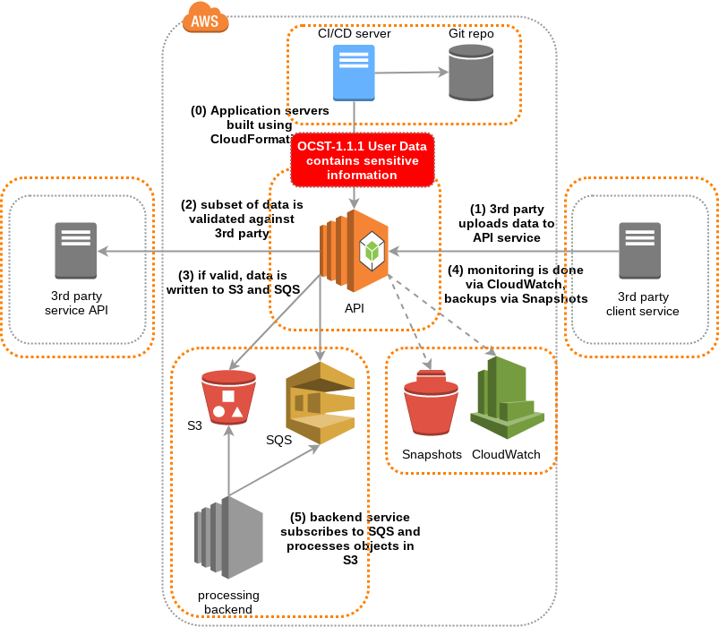

Slide 78
@aws @ec2
Feature: User Data does not contain sensitive information
In order to prevent exposure of sensitive or proprietary information
As an engineer
I want to avoid putting sensitive information in User Data

Slide 79
Feature: Restoring a snapshot that contains sensitive information
In order to retrieve sensitive instance data
As an attacker
I want to restore snapshots into an instance I control
Scenario: Restoring a snapshot
Given an EBS snapshot for an instance containing sensitive information
And an instance that the attacker controls
And a principal with the allowed permissions needed to read and restore snapshots
| action | description |
| ec2:DescribeSnapshots | Get a list and details of the available snapshots |
| ec2:CreateVolume | Creates a new volume from the snapshot |
| ec2:AttachVolume | Attach the new volume to the EC2 instance |
When the attacker restores the snapshot to the instance
And the attacker searches the snapshot filesystem for interesting data
| data |
| credentials |
| private keys |
| log files |
Then the sensitive information is returned to the attacker

Slide 80
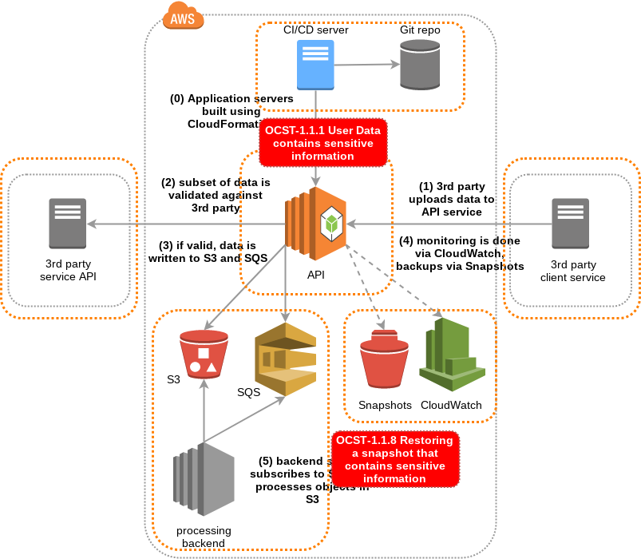

Slide 81
In order to prevent unauthorised access to Snapshot backups As an engineer I want to limit the roles that have the ability to read and restore snapshots

Slide 82
Feature: S3 buckets containing proprietary or sensitive information are public
In order to get access to secret, sensitive or customer data
As an attacker
I want companies to accidentally make private S3 buckets public
Scenario: Discovering public buckets using Bucket Finder
Given an S3 bucket containing sensitive information
And the bucket has a predictable global name
And a wordlist of possible bucket names
When Bucket Finder is executed using the wordlist
Then the public bucket is found
And the contents is available to download

Slide 83
In order to prevent accidental exposure of sensitive data via a public S3 bucket As an engineer I want to ensure private buckets cannot be made public And I want detective controls in place to find public buckets

Slide 84
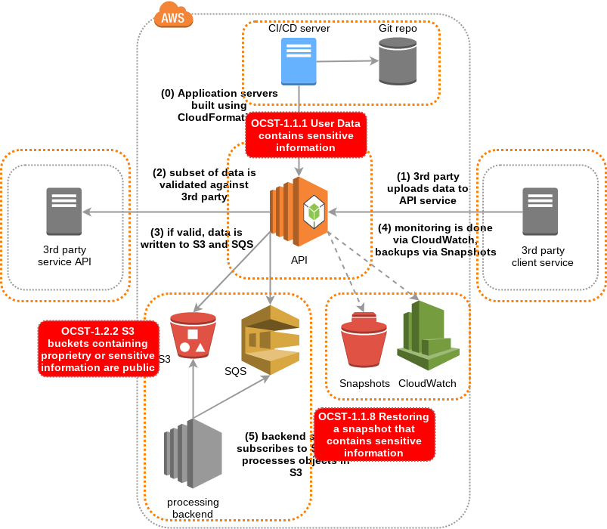

Slide 85
Feature: Unprotected access keys
In order to gain additional access to resources in an account
As an attacker
I want to find unprotected API access keys
Scenario Outline: Finding exposed access keys
Given a principal with existing API access keys
And a <storage-system>
When the user stores their access keys in the <storage-system>
And the attacker scans the <storage-system> for access keys
Then the attacker finds the access keys
And the attacker can use the access keys to access resources in the target account
Examples: Non-exhaustive list of possible storage systems
| storage-system |
| S3 bucket |
| Git repository |
| Filesystem with weak protection |
| Wiki or documentation system |
| Email or other communication platform |

Slide 86
In order to prevent exposure of privileged IAM access keys As an engineer I want to use instance profiles and locked down IAM policies

Slide 87
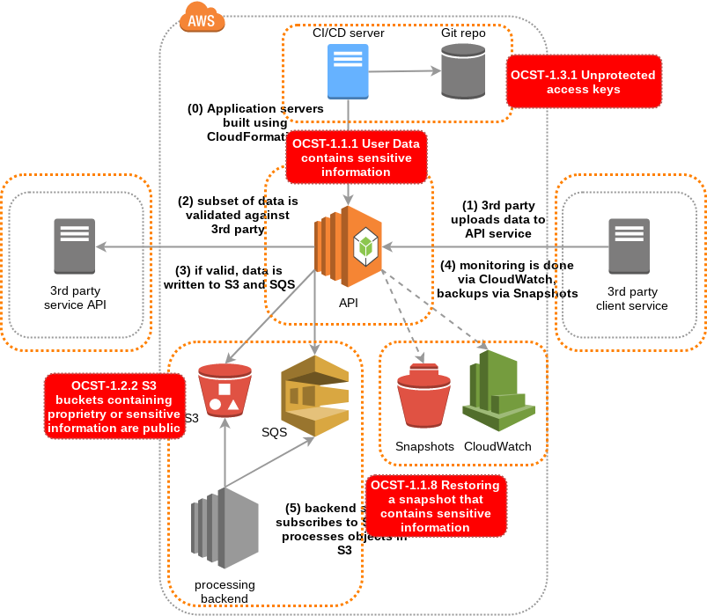

Slide 88
What about SQS? Also, this service could possibly be built using Lambda, should we threat model that too?
We’re running out of time for today. You could start scheduling regular threat modeling sessions, for example after every sprint planning. If you need me to join or facilitate, I’d be more than happy to.

Slide 89
If we found interesting threats for SQS and Lambda, could we contribute them back to the project?
Yes! It’s a community-driven project. The more contributions it gets, the more value it can provide to everyone.
Great! I’m looking forward to our next threat modeling session. It has been great working so closely with the security team. Thank you!

Slide 90
Challenges
Early days, project needs to grow
Needs people - researching and creating content takes time
Can’t provide control implementations that work for everyone - reference code perhaps?
You might know of good cloud threats at your org but can’t share because of exposure concerns

Slide 91
In summary
Threat modeling is awesome
Threat modeling is easy
You should be threat modeling
Cloud is awesome
You should be using the OWASP Cloud Security project :)
You should contribute to the OWASP Cloud Security project :p

Slide 92

Thank you!
@owasp_cloudsec

